Slide 1

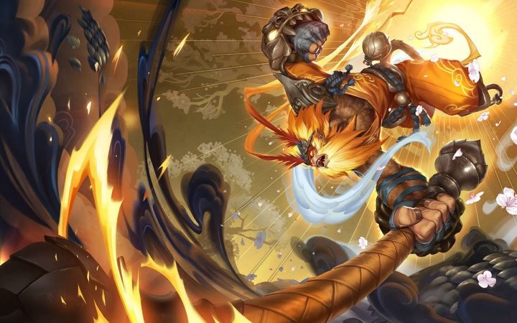
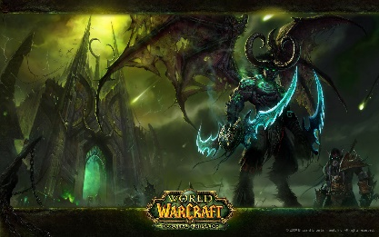



Why
Online Games Attractive
Toast Master Speaker Topic
Owen Li

Slide 2

Toast Master Speaker Topic : Why online games attractive
I want an account

Slide 3

Toast Master Speaker Topic : Why online games attractive
Dopamine
Brain secretes dopamine to make people feel happy

Slide 4
Toast Master Speaker Topic : Why online games attractive
Role Play
Allow players to be the character in the game instead a player playing the game
Exploration
Make environment of every level different to keep freshness
Relationship
Allow players to act as a team or an enemy
High Score
Give the players the reward to make them feel achivement

Slide 5
Thank You
Why online games attractive
By Owen

